Slide 1


Slide 2
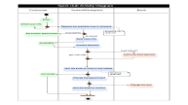
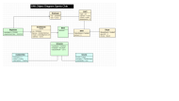
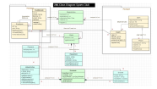
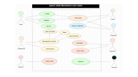
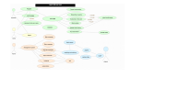
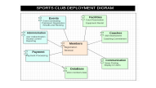
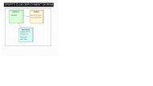
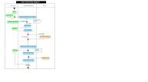
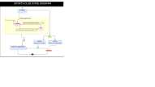
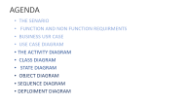
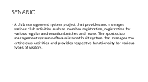
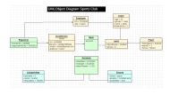

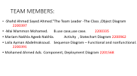
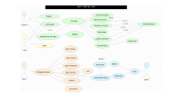
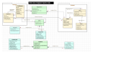
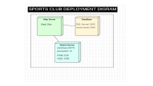
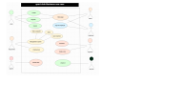
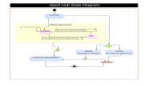
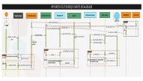
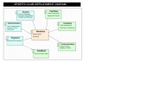
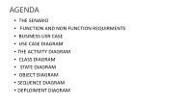
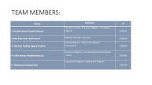

Slide 3
TEAM MEMBERS:
Name | Function | ID
1-Shahd Ahmed Sayed Ahmed. | The Team Leader - The Class Diagram –The Object Diagram. | 2200397
2-Mai Mammon Mohamed. | Business use case - use case. | 2200335
3- Mariam Nakhla Ageeb Nakhla. | Activity Diagram – State chart Diagram- presentation. | 2200962
4- Laila Ayman Abdelmaksoud. | Sequence Diagram – Functional and nonfunctional - Word. | 2200391
5- Mohamed Ahmed Ads. | Component Diagram –Deployment Diagram. | 2201568

Slide 4
AGENDA
THE SENARIO
FUNCTION AND NON FUNCTION REQUIRMENTS
BUSINESS USR CASE
USE CASE DIAGRAM
THE ACTIVITY DIAGRAM
CLASS DIAGRAM
STATE DIAGRAM
OBJECT DIAGRAM
SEQUENCE DIAGRAM
DEPLOIMENT DIAGRAM

Slide 5
SENARIO
A club management system project that provides and manages various club activities such as member registration, registration for various regular and vacation batches and more. The sports club management system software is a net built system that manages the entire club activities and provides respective functionality for various types of visitors.

Slide 6
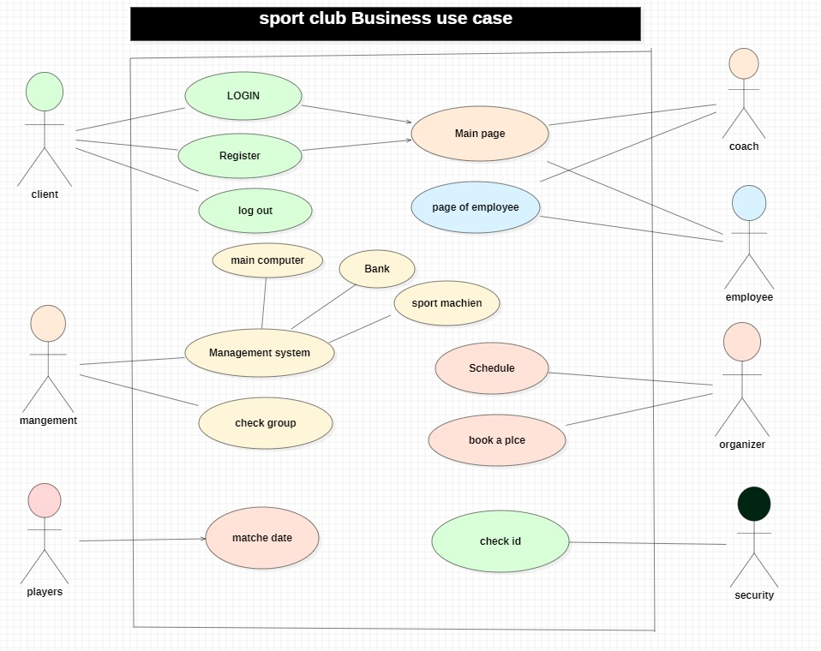

Slide 7
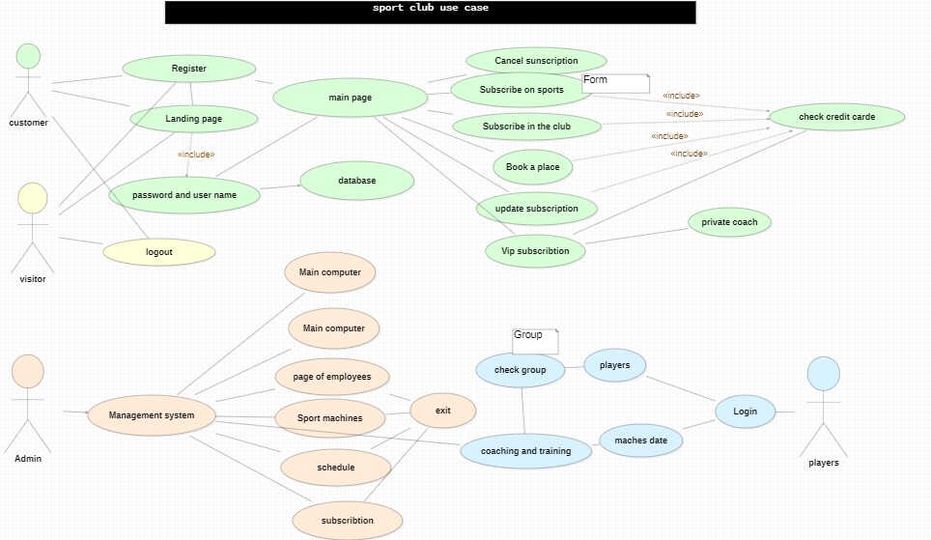

Slide 8
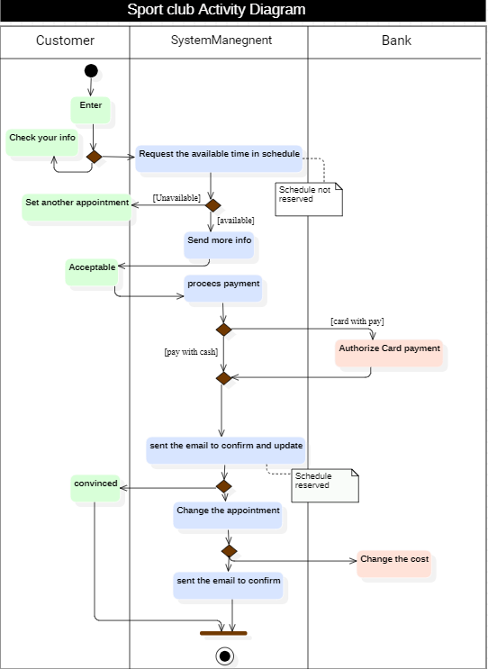

Slide 9
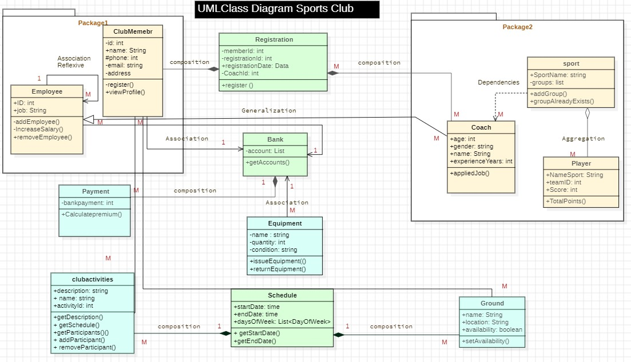

Slide 10
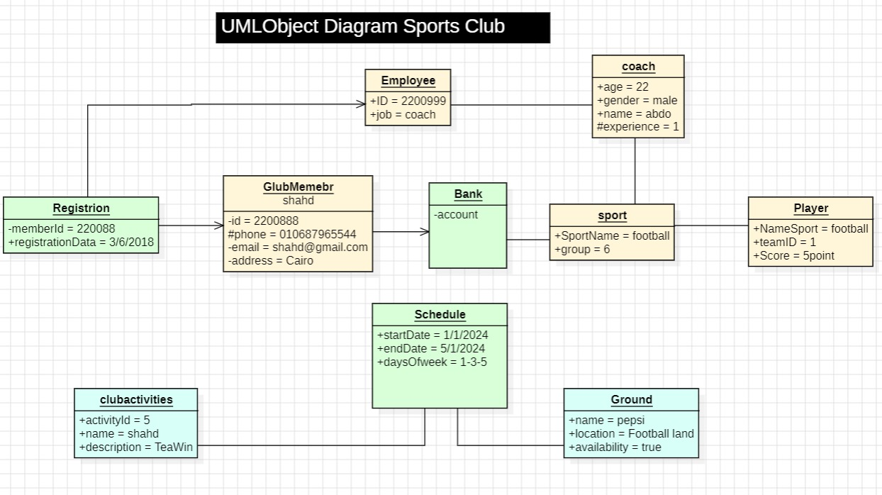

Slide 11
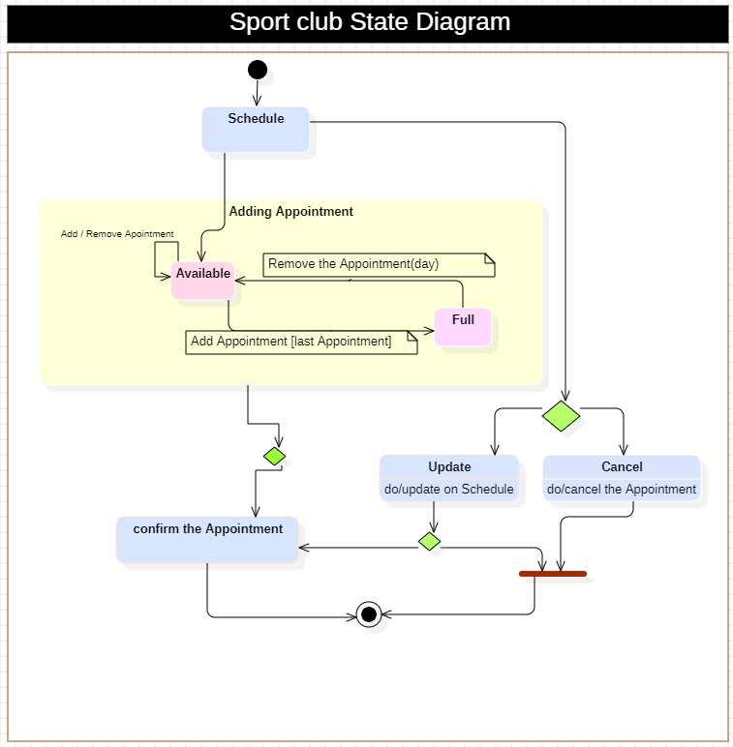

Slide 12
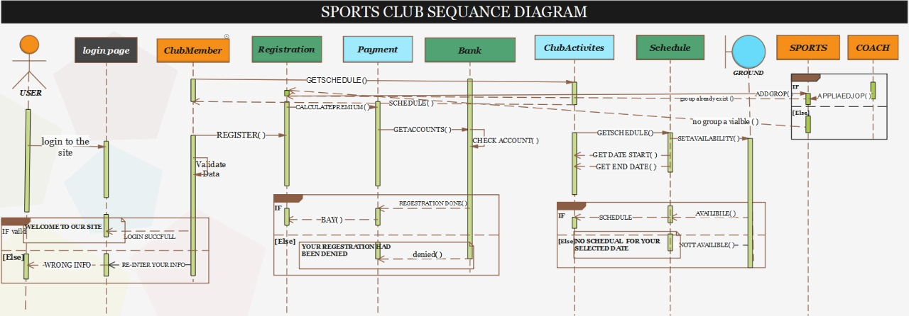

Slide 13
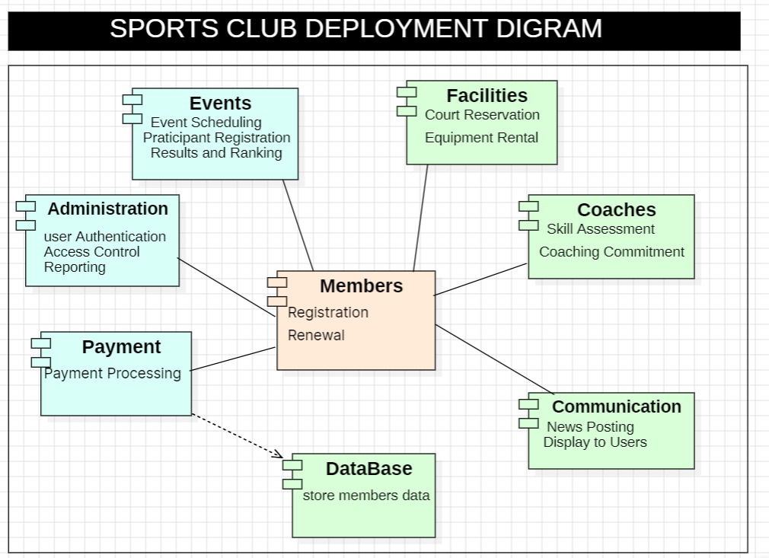

Slide 14
